Slide 1
Leanne McSkimming, ISR Director

Slide 2
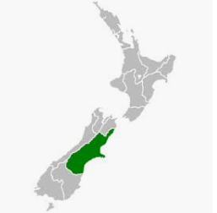
What is Integrated Safety Response
Multi-agency approach responding to family violence reporting via Police and High Risk prison releases.
Part of the Government's family violence and sexual violence work programme under the Joint Venture
Police are the operational lead on behalf of partners
The pilot commenced on 1 July 2016 to ensure a new national model is robust, adaptable and makes a real difference to the lives of families and whanau
Covers the Canterbury Police District
Operates 7 days a week.

Slide 3
What are the objectives
To ensure the safety of families and whanau as soon as possible post episode.
To ensure early identification of risk and appropriate response to at-risk whānau at the first opportunity so as to:
Support Victims, Perpetrators and tamariki
reduce re-victimisation/re-offending and
improve long-term outcomes for whanau.

Slide 4
How the model differs
Ministerial mandate
Operates Seven days per week
Multi-agency information sharing and decision making
ISR Risk assessment framework and Practice guidelines
Full time paid NGO positions with increased support for high risk victims, a dedicated perpetrator service and whanau support workers
Multi-agency Case Management System

Slide 5
Why is a multi-agency response needed?

Slide 6
Our Statistics
Episodes of family harm = 35,288
3% - Sexual Violence
10% - Threats of harm
11% - Property Damage
20% - Physical Violence
56% - Verbal Abuse
Episodes involving children = 18,188
Total People involved in Family Harm = 43,627
22,481 of which are male
22,986 of which are female
43 of which are gender diverse
Perpetrators of violence:
28% Female
72% Male

Slide 7
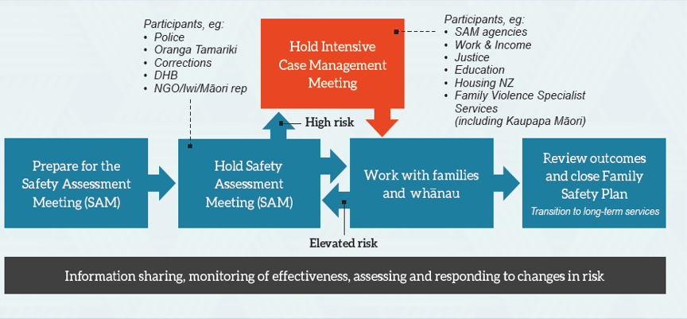
How the model works to ensure safety of all parties

Slide 8
Types of interventions
High Risk
Independent Victim Specialists & Perpetrator Outreach Service
Medium Risk
Whanau Support Workers
Low Risk
Phone based response

Slide 9
Prevention Initiatives

Slide 11
Navigators in cells
7 days per week – 6.30am to 9.30am
Support engagement with perpetrators held in custody due to family violence alongside police and mental health nurses.
Start the journey of change to support engagement outside the cells.
Link into external support networks and ISR

Slide 12
Notes:
FV offences dropped from 17% to 10%
Victimisation dropped from 16% to 8%
Self reported changes decreased significantly on completion of service for victims across all markers of family harm

Slide 14
Results to date
73% of victims who engaged with ISR accessed support services
70% of perpetrators who engaged with ISR accessed support services
68% of cases had no further episodes of family harm
81.7% of Perpetrators who engaged with Navigators had no further episodes of Family Harm
18% Reduction in Maori re-victimisation

